Slide 1


Importance of varnish on boats
Unique Yacht Detailling

Slide 2
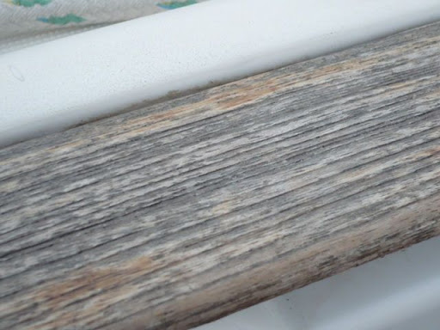
Moisture protection:
Wood on boats is constantly exposed to water, both fresh and salt, which can cause rot, warping, and deterioration. Varnish creates a protective barrier that prevents moisture from penetrating the wood.

Slide 3

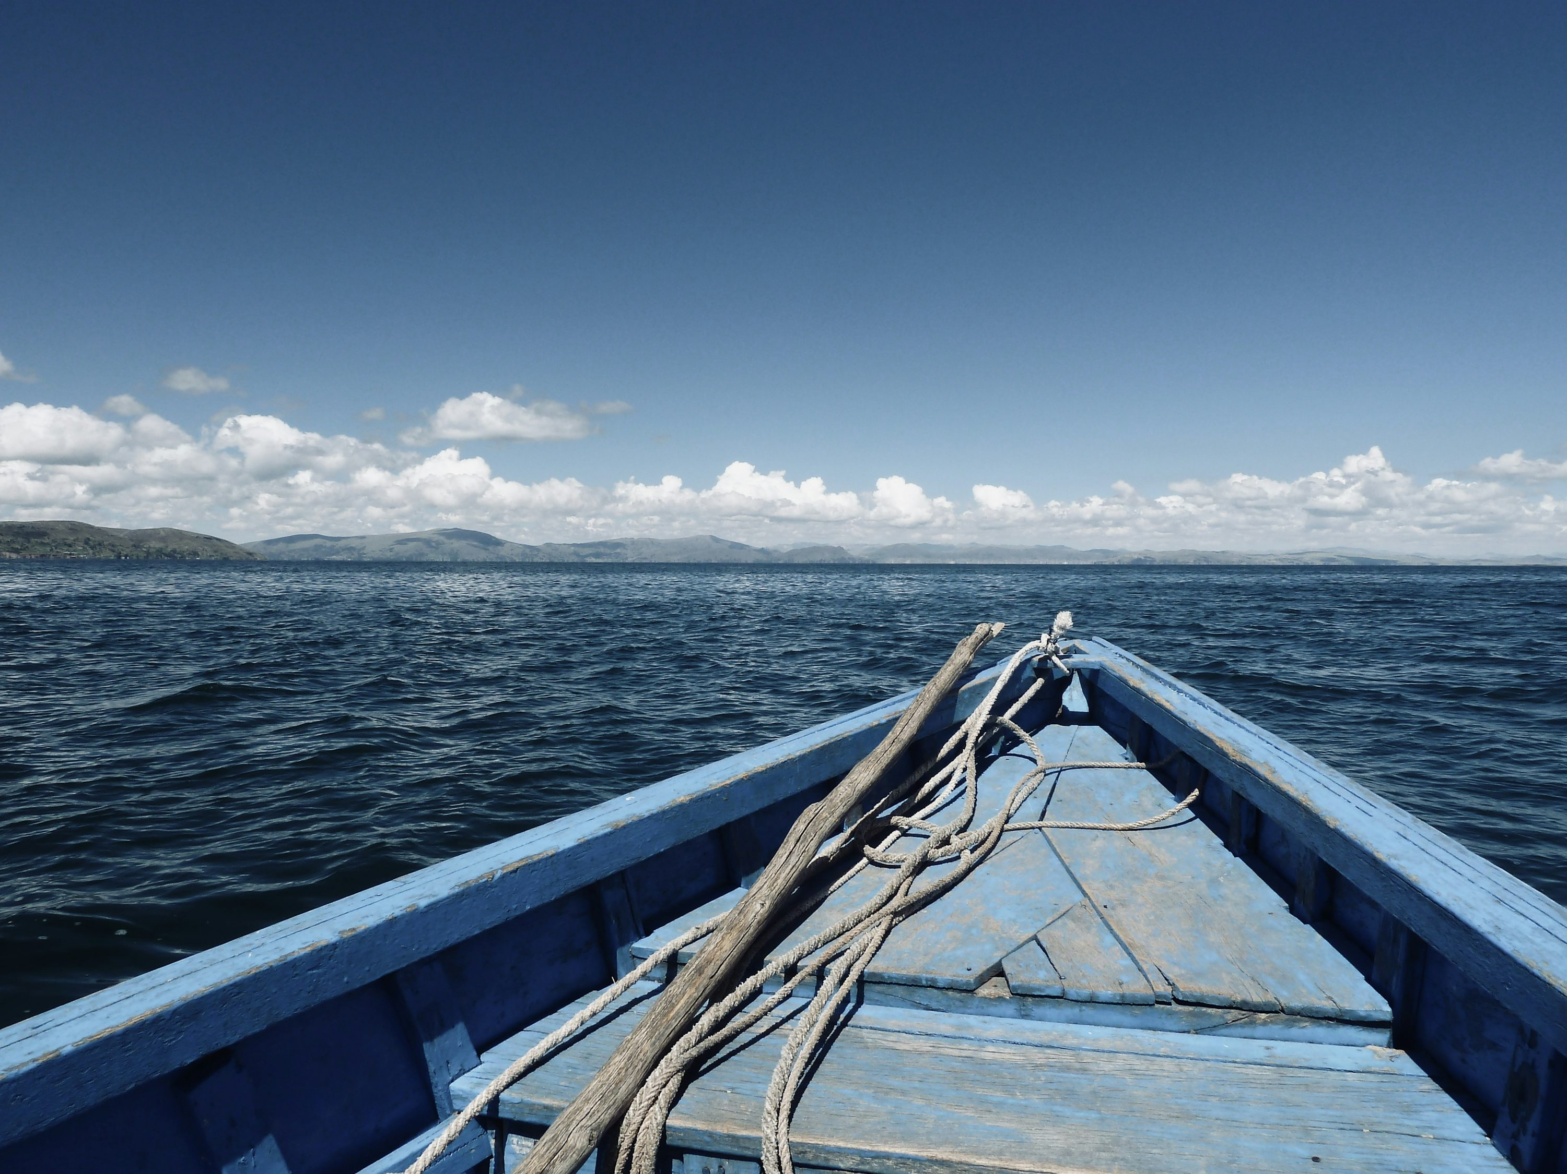
UV Protection:
The sun's ultraviolet rays can damage wood, making it brittle and discoloring it. Marine varnishes contain UV inhibitors that protect the wood from these effects.

Slide 4
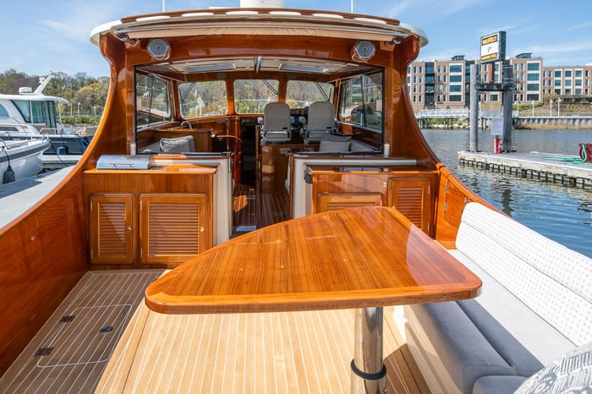
Durability and resistance:
The varnish increases the wood's resistance to wear, scratches, and impacts, which is essential for a boat that is used frequently.
Durability and resistance:
The varnish increases the wood's resistance to wear, scratches, and impacts, which is essential for a boat that is used frequently.
Maintenance:
Although the varnish protects the wood, it is important to perform periodic maintenance, including light sanding and applying additional coats, to ensure its long-term effectiveness.

